Slide 1
Investment and Development Agency of Latvia
Tourism department
meetlatvia@liaa.gov.lv

Slide 2
Key information about Latvia
Capital: Riga
Currency: EUR
Schengen Area: member since 2007
European Union: member since 2004
Population: 1.9 million
Area: 64,589 km2
Density: 30/km2

Slide 3
Facts about technologies
#2 Fibre optic coverage in Europe
#6 Mobile data usage per month in the world
#8 Internet speed in the world
90% of households connected to internet

Slide 4
Leading industries of Latvia
Chemical industry and pharmaceuticals
Information technology
Mechanical engineering and metalworking
Woodworking and forestry
Food industry
Clothing and textile

Slide 5
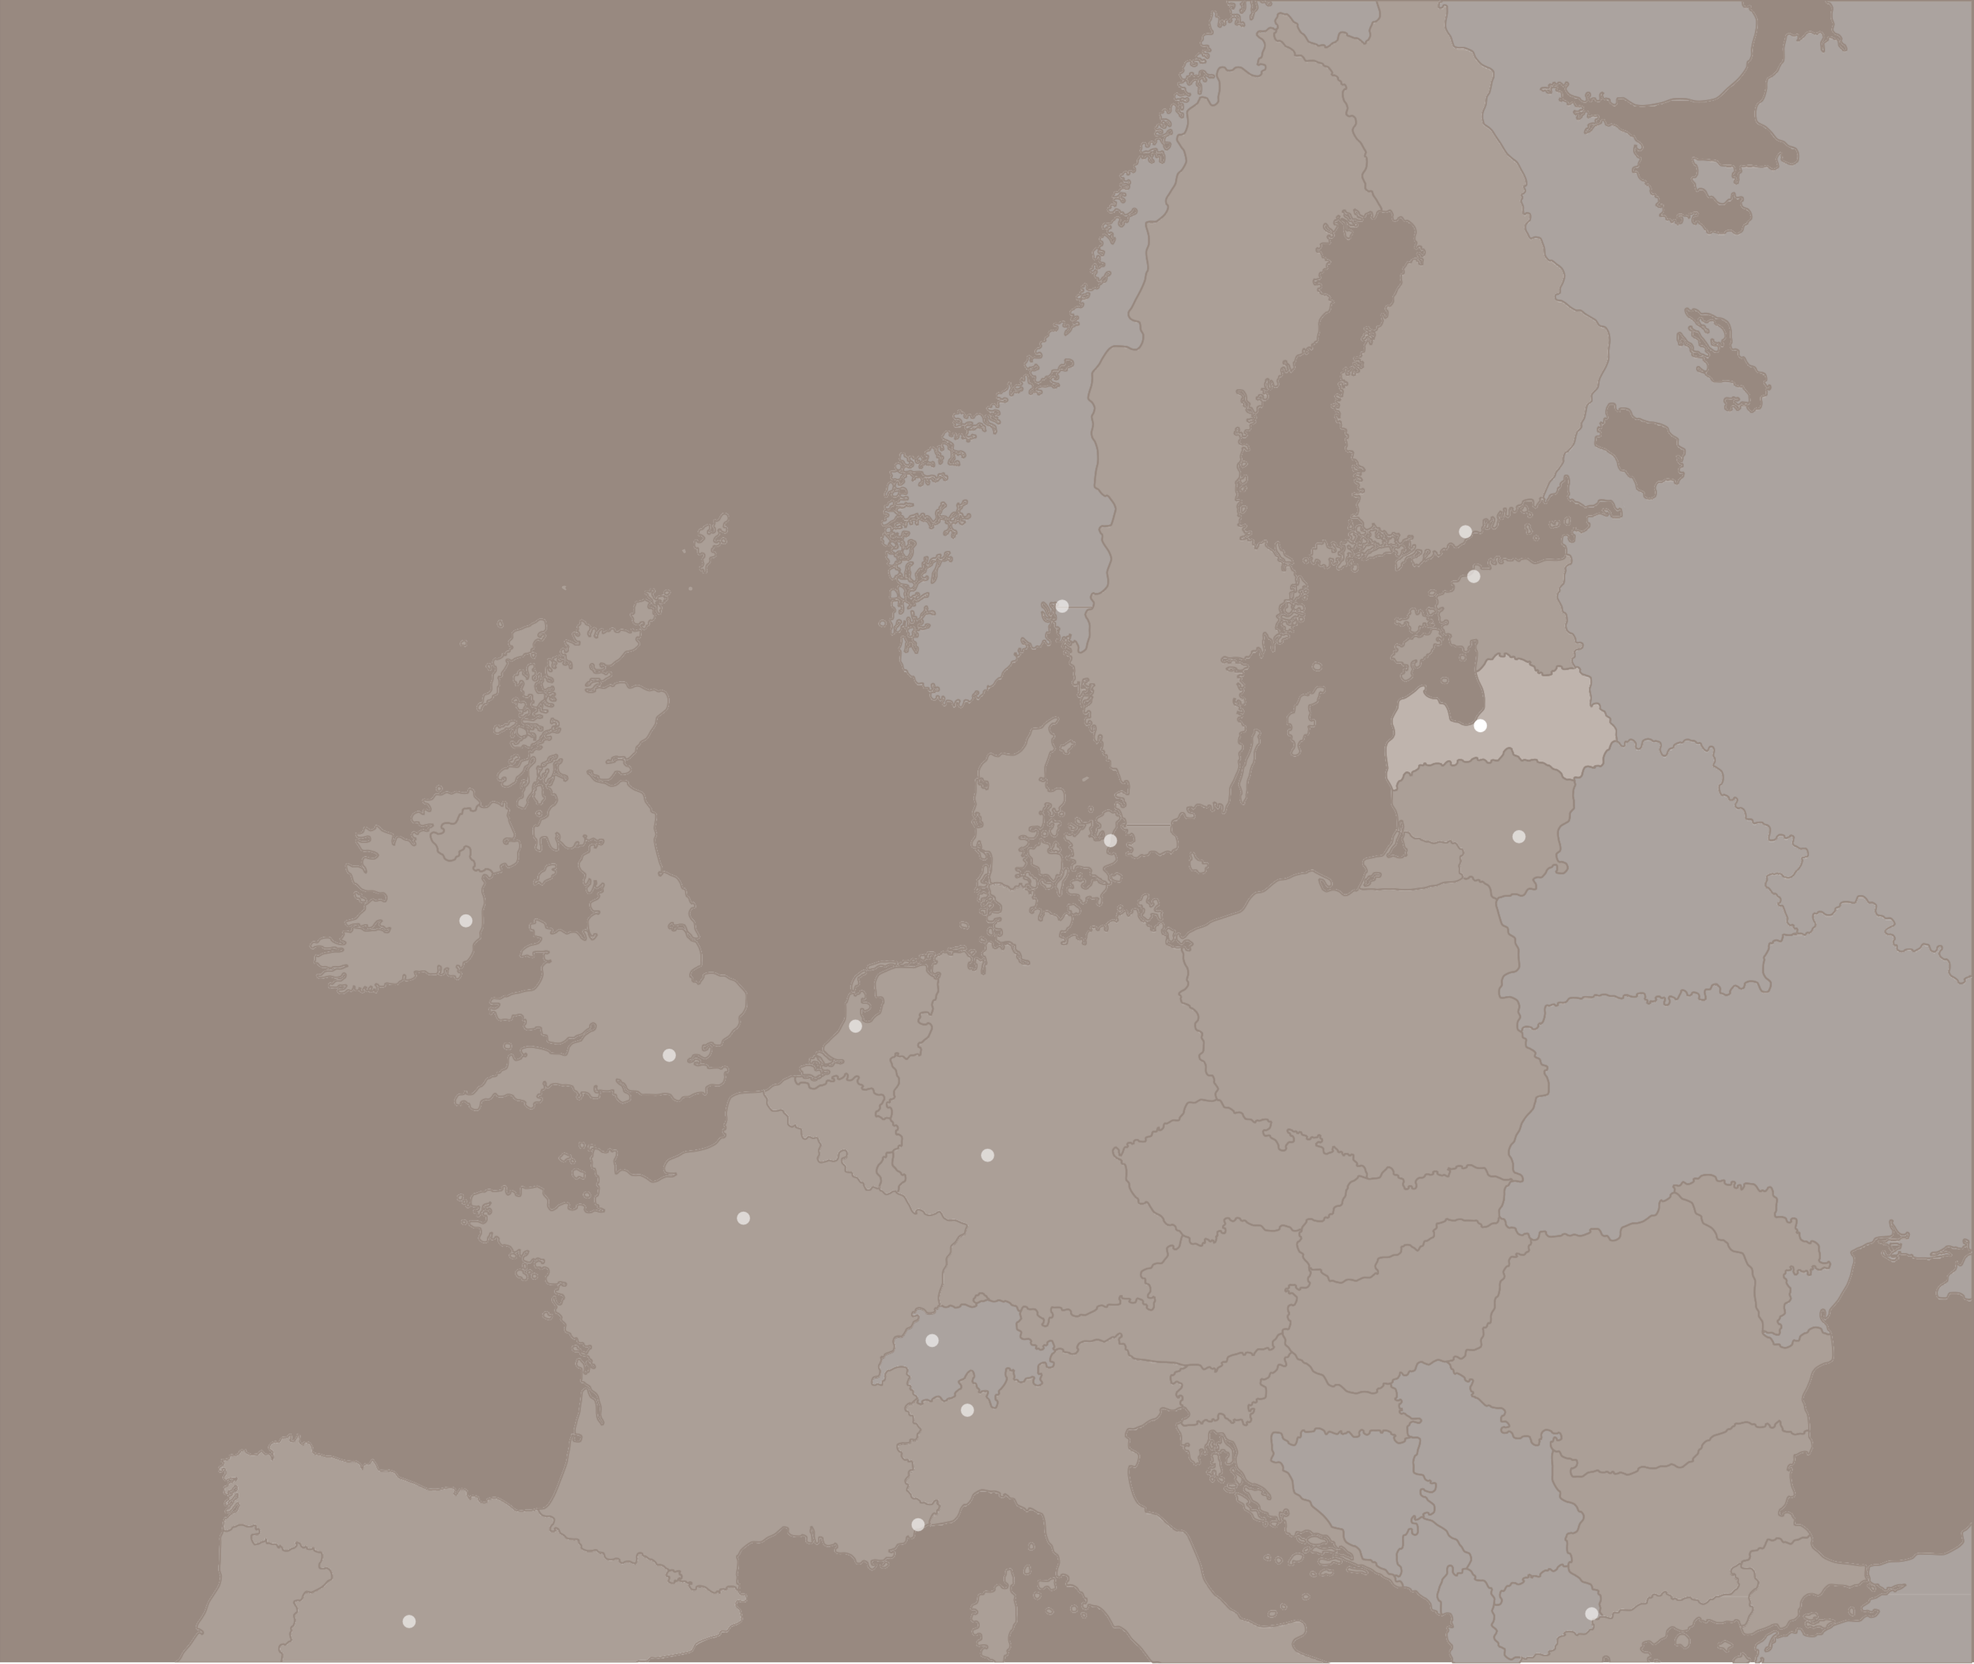
Riga - home
Latvia in Europe
of
Less than 3 hours away from the majority of European
Helsinki
Oslo
Stockholm
Tallinn
Air traffic hub of the Baltics
capitals
More than 100 direct flights
3h flight
2h flight
1,5h flight
Riga
Copenhagen
Vilnius
Dublin
airBaltic Codeshare partners:
London
Berlin
Warsaw
Amsterdam
Frankfurt
Prague
Bratislava
Paris
Vienna
Chisinau
Bern
Budapest
Ljubljana
Zagreb
Bucharest
Milan
Belgrade
Monaco
Sarajevo
Sofia
Rome
Podgorica
Skopje
Madrid

Slide 6
You are only two handshakes away from anyone in Latvia
Two allies to bring any idea to life

Slide 7
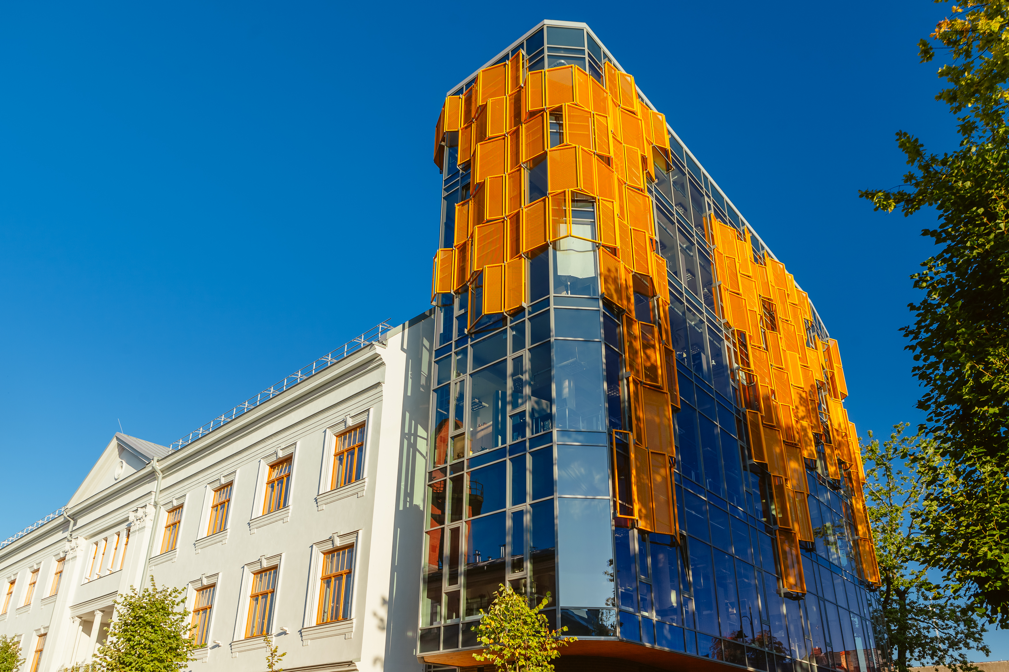
Wide variety of venues
In the past and nowadays Latvia has been a meeting point between West, East and North. That’s why various venues are available throughout Latvia - both historical and modern. Here you will find more than 350 listed meeting venues in Latvia, many of them equipped with cutting-edge technology.

Slide 8
House of the Blackheads
The Black Heads house is located in the very heart of Riga Old Town.
For nearly 700 years it is among the most splendour buildings of the city, home to the unique history of the legendary Brotherhood of the Black Heads and the city itself.
Banquet: 250
Theatre: 340
Halls: 7

Slide 9
The Museum of the History of Riga and Navigation
The oldest public museum in Latvia, which dates back to 1773. The Museum tells history of the creation and development of Riga over 800 years, as well as shipping in the territory of Latvia from the 10th century until today.

Slide 10
Rundale Palace
One of the finest Baroque architecture style examples in Latvia, based on the project by architect Francesco Bartolomeo Rastrelli.

Slide 11
Splendid Palace
The first cinema in the Baltics to screen sound films. It has been recognised as the most elegant high-level conference venue in Riga and, therefore, it has repeatedly been the stage for TEDx and other high-level conferences.
Theatre: 557
Halls: 3

Slide 12
Spilve Airport
A former civilian and military airport, located 5 km from Riga’s city centre, from which aircraft took off as early as the First World War. It became the first international airport of Riga in the 1920’s. Nowadays it is a venue for celebrations, sporting events, art projects, concerts, seminars, photo shooting, filming, advertising production and air shows.
Banquet: 500
Airfield: 5000

Slide 13
National Library of Latvia
Just a bridge span from Old Town, on the left bank of the Daugava, looms an extraordinary, culturally significant edifice, the Castle of Light – the New National Library of Latvia.
Theatre: 700
Halls: 15

Slide 14
Radisson BLU Latvija Conference & SPA Hotel
Latvia’s largest conference hotel, situated between Riga’s iconic Old Town and majestic Art Nouveau district, both included in UNESCO World Heritage list.
Theatre: 1100
Halls: 24
Rooms: 571

Slide 15
Hanzas Perons
A former Riga cargo railway warehouse has been reborn as a platform for culture, art, music and other events. Combining building’s more than 100 years of history with a modern approach it has become an e cient, functional space to organize and hold events.
Theatre: 1200

Slide 16
ATTA Centre
10 minutes from Riga City Center
20 minutes from Riga International Airport
22 break-out rooms
Rooftop restaurant and open air-terrace
Easily customize facilities from small groups to large conferences
Capacity up to 3000 people

Slide 17
Estonia
Meeting Destinations in Latvia
Valmiera
Ventspils
Cēsis
Sigulda
Kuldīga
Rīga
Baltic Sea
Jūrmala
Rēzekne
Liepāja
Daugavpils
Lithuania

Slide 18
Jūrmala
Largest resort city in the Baltics
15 km from Riga International airport
More than 40 hotels with capacity up to 4000 beds
Biggest hall up to 600 pax indoors
2100 pax outdoors
Unique event venues
Historical wooden villas
Open-air museum
Summer residence of Kristaps Morbergs
Incentive programs from fish smoking to bog shoeing

Slide 19
Cēsis
One of the oldest cities in Latvia
Situated in Gauja National Park
Largest venue up to 800 pax
Incentive ideas from medieval knight activities to vertical wind tunnel & bobsleigh fun run

Slide 20
Liepāja
Historical port city
Domestic flights from Riga
The city can accomodate more than 1500 guests
19 restaurants
35 cafes
Simultaneous catering for 2600 guests
European Capital of Culture 2027

Slide 21
Riga
Direct flights up to 100 destinations
Airhub of the Baltics with up to 100 direct flights9 km from Riga International Airport
17’000+ beds in the city
50+ business exhibitions annually
(~7’000 exhibitors & around million attendants)
NATO Summit, the World Ice Hockey Championship, Eurovision, Latvia Presidency of the Council of the European Union and many international conferences.

Slide 22
Characters of Riga
UNESCO listed historic centre
Medieval Riga Old town
Around 800 Art Nouveau buildings
More than 3500 wooden houses

Slide 23
Incentives in the city
airBaltic Training
Fiat 126 City rally & city coding
Curling Experience

Slide 24
Incentives in the city
Riga Old Town & Art Nouveau walking tours
Riga Central market tour & cooking classes
SUP on the Daugava

Slide 25
Incentives are in our history
Medieval balsam tasting / dinner
Bread making workshop
Rundale Palace activities

Slide 26
Incentives are in our history
KAROSTA
Naval Prison
Ligatne Bunker
Once top-secret Soviet bunker
Irbene radio telescope
Ventspils International Radio Astronomy Centre

Slide 27
Incentives are in our nature
Bog walking
10% of Latvia is covered in blogland
Forest foraging
pick up chanterelles
50% of Latvia is covered in forest
Fish smoking
475 km of white sand beach

Slide 28
Incentives are in our nature
Off-road
Fatbikes
Golf

Slide 29
Bungee jumping
Aerodium
Vertical wind tunnel
Zerglis

Slide 30
The population density of Latvia is 30 per km2, what provides plenty of fresh air
Catering in the nature
Dinner on the lake
Latvian bathouse

Slide 31
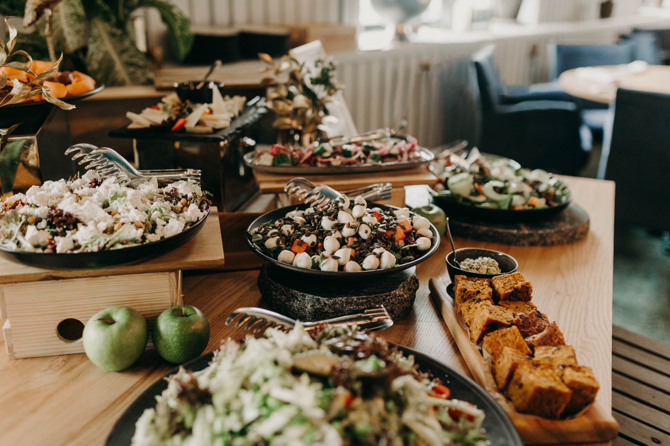
Restaurants
Various restaurants offer high quality meals for all tastes and budgets. Beautifully served dishes made with local ingredients by world-class chefs – pure value for your money.

Slide 32
Contacts
Event organizers
Destination Management Companies Professional Congress organizers
3K MANAGEMENT Phone: +371 27 818 065
Email: write@3k.lv www.3k.lv/en
Baltic Incentive Travel Phone: +371 29 150 794
Email: janis@balticincentive.com www.balticincentive.com/en
Estravel Latvia
Phone: +371 67 288 4 9 4
Fax: +371 67 287 977
Email: info@estravel.lv www.estravel.lv/en
Con-ex Latvia Tours group Phone: +371 67 085 022
Email: mice@con-ex.com www.con-ex.com
DMC VIA Baltic
Phone: +371 67 240 301
Email: tours@dmcviabaltic.eu www.dmcviabaltic.eu/en
Bubbles&more
Mikus iela 20-1, Rīga, LV-1083
Phone: +371 2366 9123
Email: linda@bubblesandmore.lv
www.bubblesandmore.lv
Baltic Travel Group
Phone: + 371 67 228 428
Fax: + 371 67 228 337
Email: info@btgroup.lv www.baltic.travel

Slide 33
Contacts
Event organizers
Destination Management Companies Professional Congress organizers
Baltic Events & Tours Phone: +371 26 803 372
Email: info@balticet.com www.balticet.com
NB DMC
Phone: +371 67 809 942
Email: valentina@nordicandbaltic.com www.nordicandbaltic.com
IMPRO Travels
Phone: +371 67 507 198
Phone: +371 67 507 209
Email: incoming@impro.lv www.impro.lv
Goal Event
Phone: +371 26 381 881
Email: question@goalevents.com www.goalevents.com
Partnering Solution Phone: +371 28 670 527
Email: info@partneringsolution.lv www.partneringsolution.lv
TheMiceCream
Phone: +371 22 588 222
Email: info@themicecream.com www.themicecream.com

Slide 34
Investment and Development Agency of Latvia
Tourism department
meetlatvia@liaa.gov.lv

